Slide 1
SIERRA PACIFIC INNOVATIONS CORP
X27 COLOR NIGHT VISION

Slide 2
COMPANY PROFILE
20 YEARS IMAGING EXPERIENCE
THERMAL – NIGHT VISION – SWIR – CMOS
SMALL BUSINESS
COTS AND CUSTOM SOLUTIONS
DEVELOPMENT CONTRACTS
MILITARY – GOVERNMENT – CIVILIAN CUSTOMERS

Slide 3
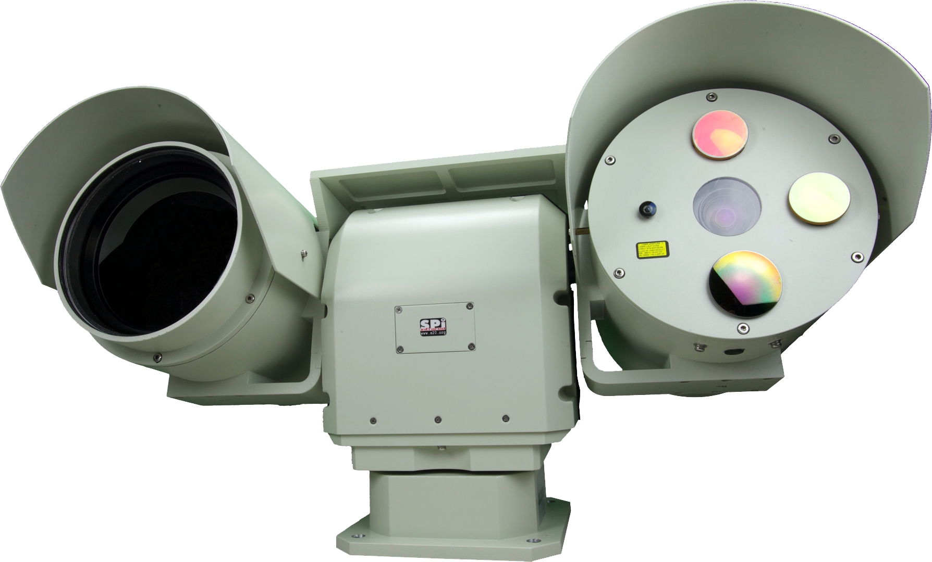
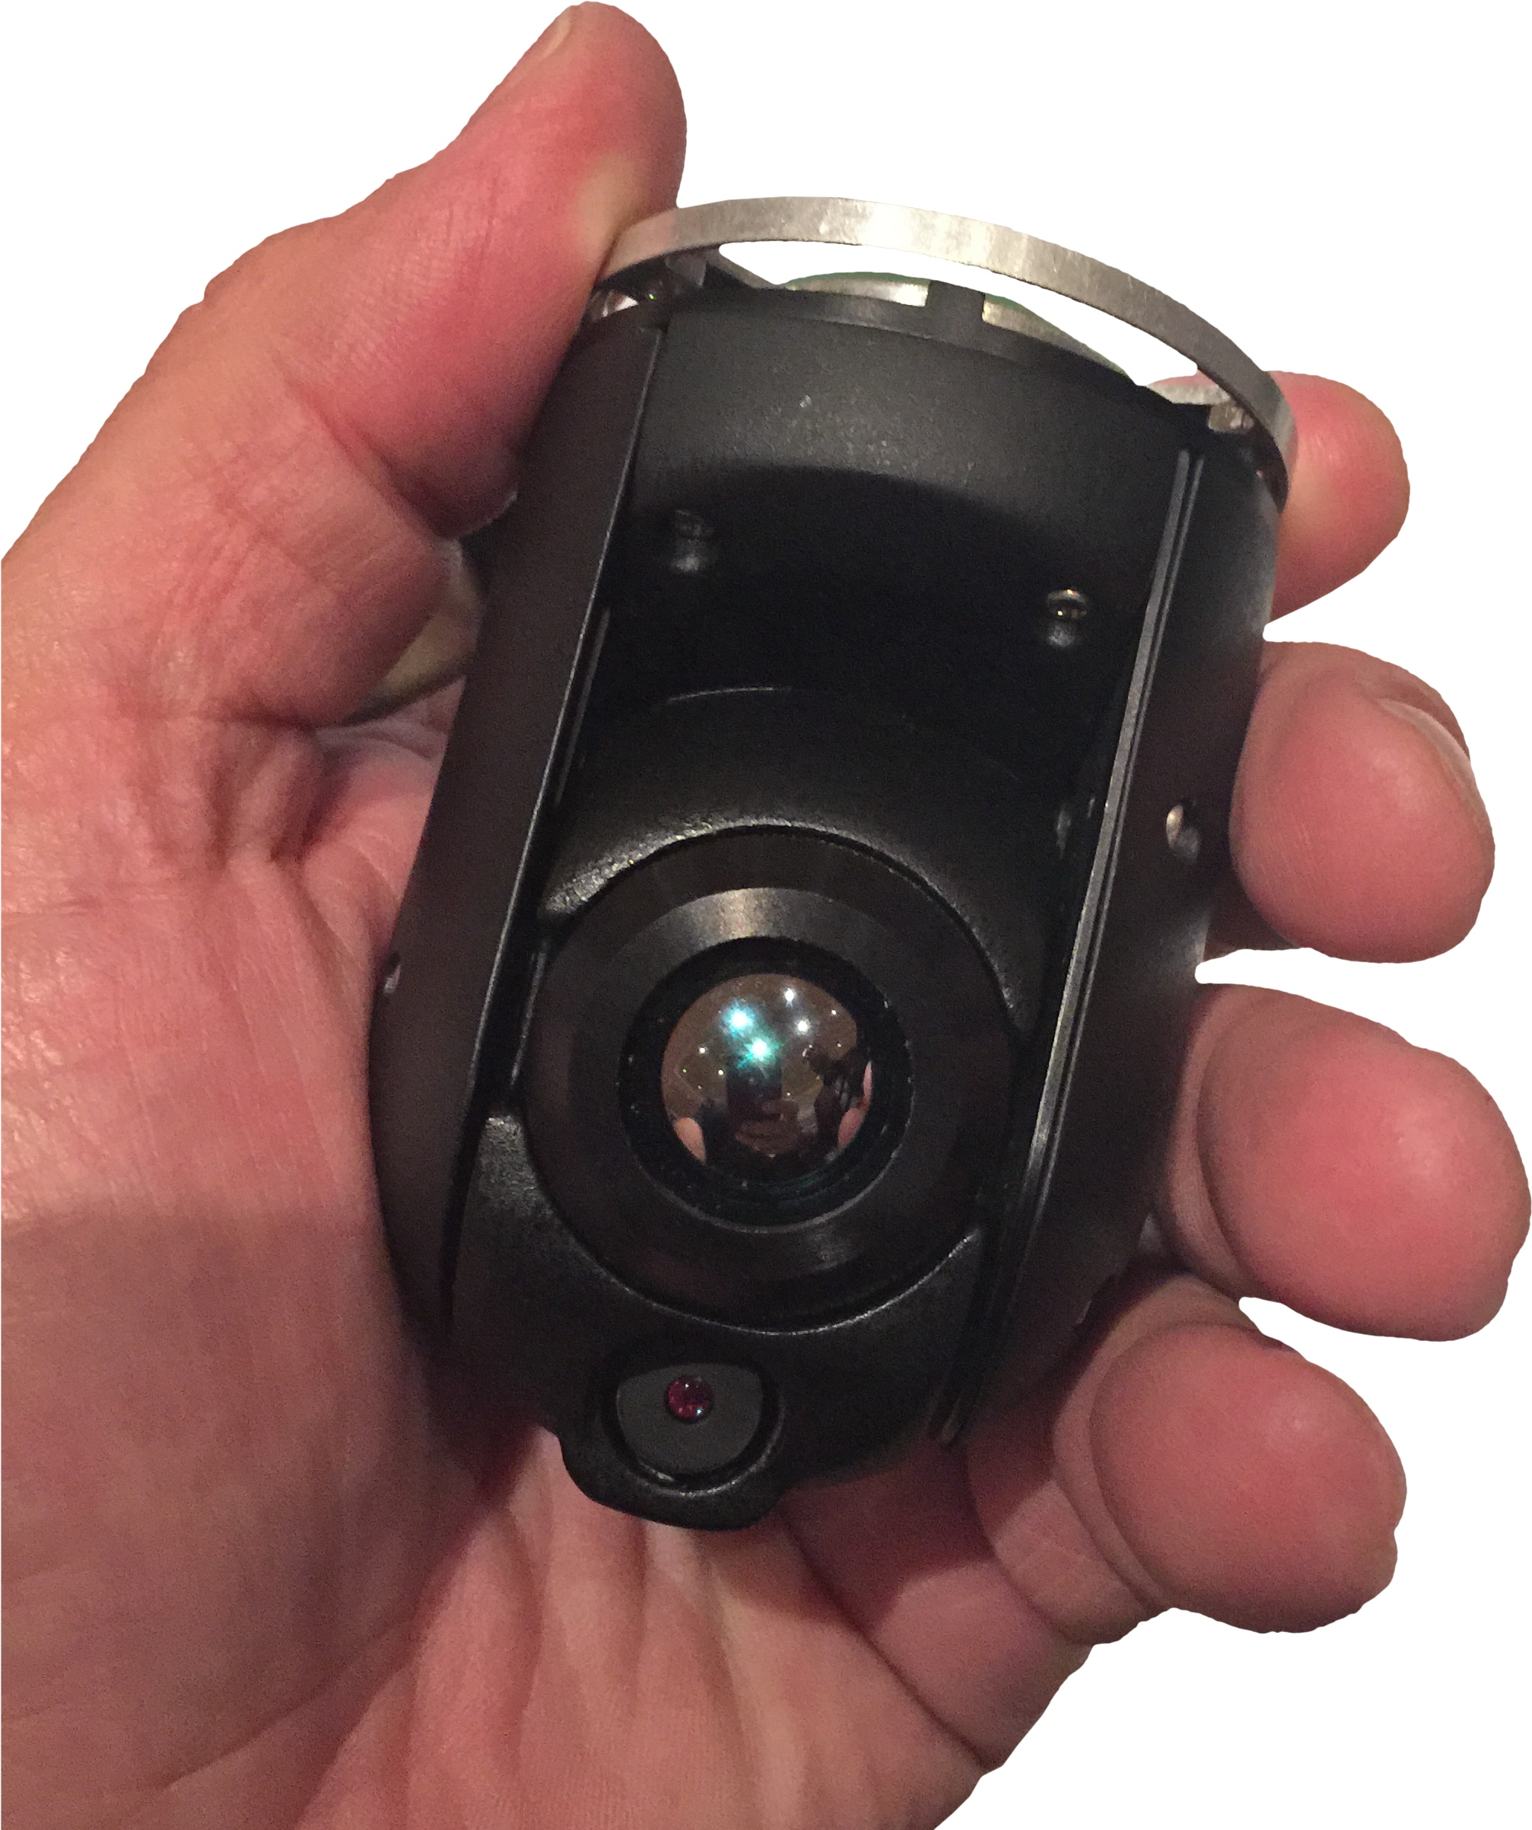
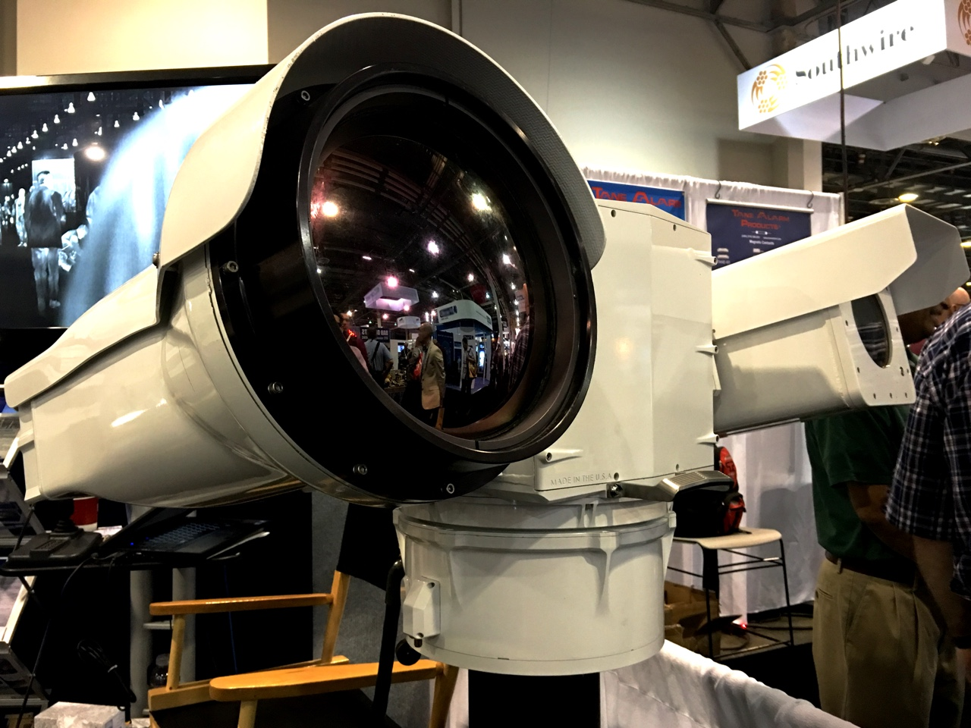
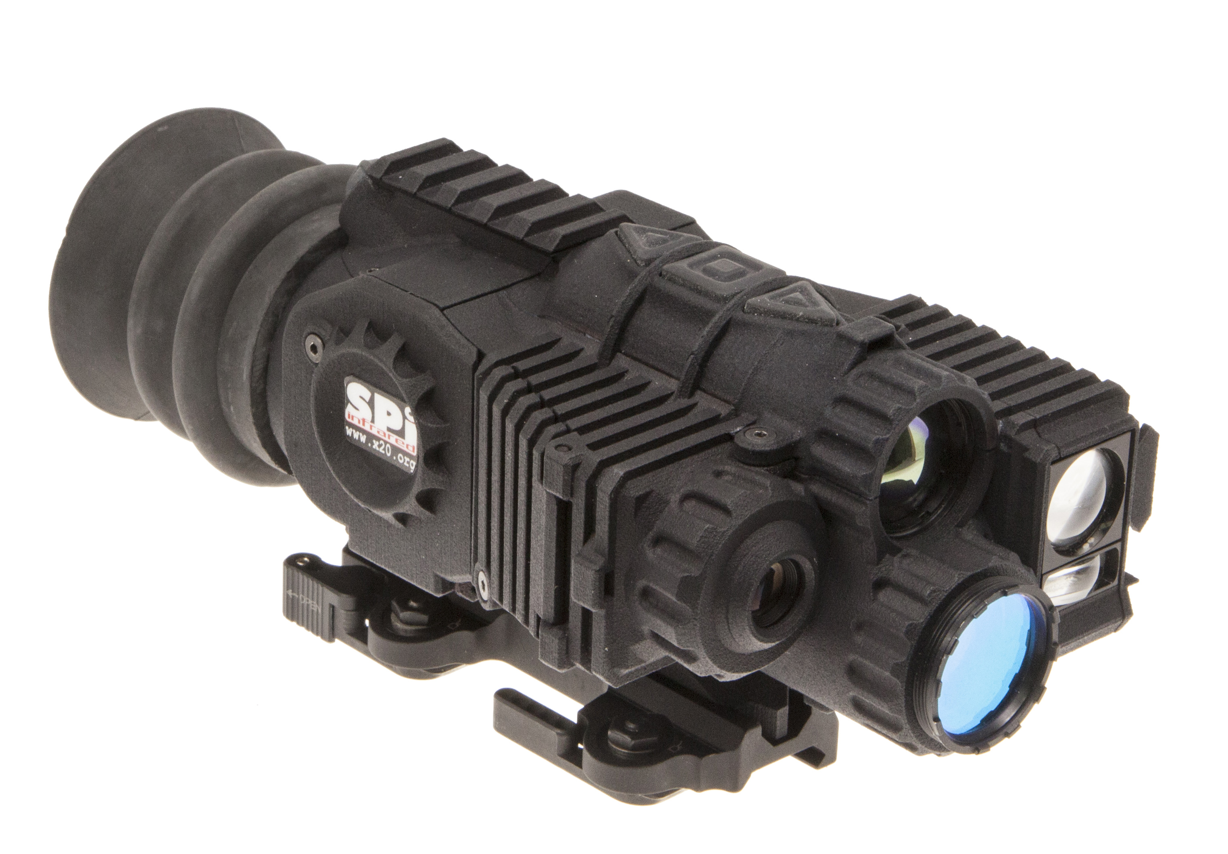
THERMAL SYSTEMS
PTZ – WEAPON SIGHTS – UAV PAYLOADS

Slide 4
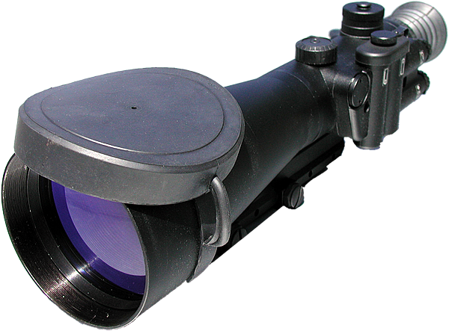
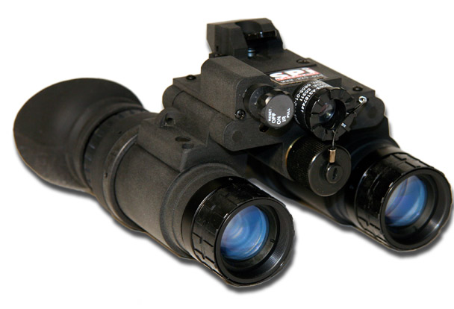
NIGHT VISION SYSTEMS
LEGACY GEN4 – WEAPON SIGHTS – I² CAMERAS

Slide 5
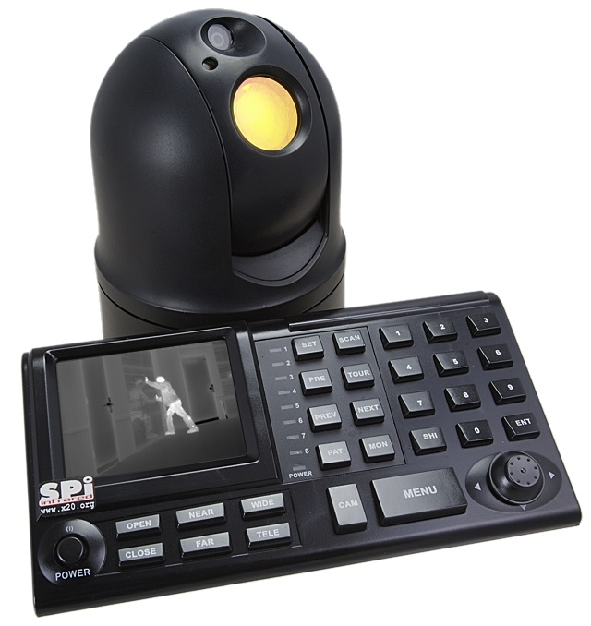
SWIR SYSTEMS
LASER IMAGING – HANDHELD - UAV

Slide 6
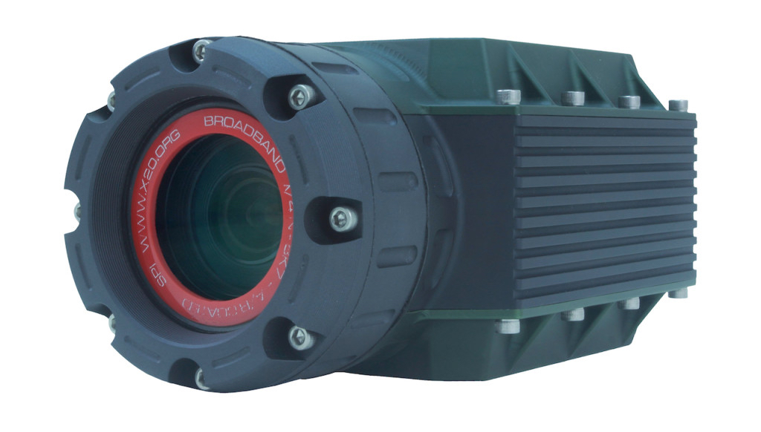
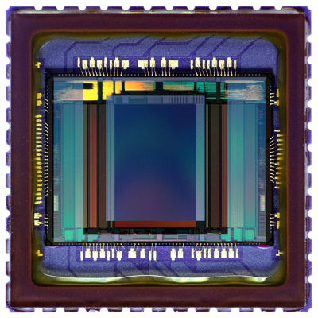
CMOS SYSTEMS
SENSOR INTEGRATION – CAMERA MODULES

Slide 7
DEVELOPMENT EFFORTS
IR&D – CONTRACTED - DARPA
X27 COLOR NIGHT VISION
INTERNAL DEVELOPMENT
DARPA TRANSAPPS PROGRAM CWO LEAD.

Slide 8
CUSTOMERS
*PARTIAL LISTING

